Slide 1

Failure of Metals
Dr. J. Venkatramani
219-B
venkatramani@iiitdm.ac.in

Slide 2
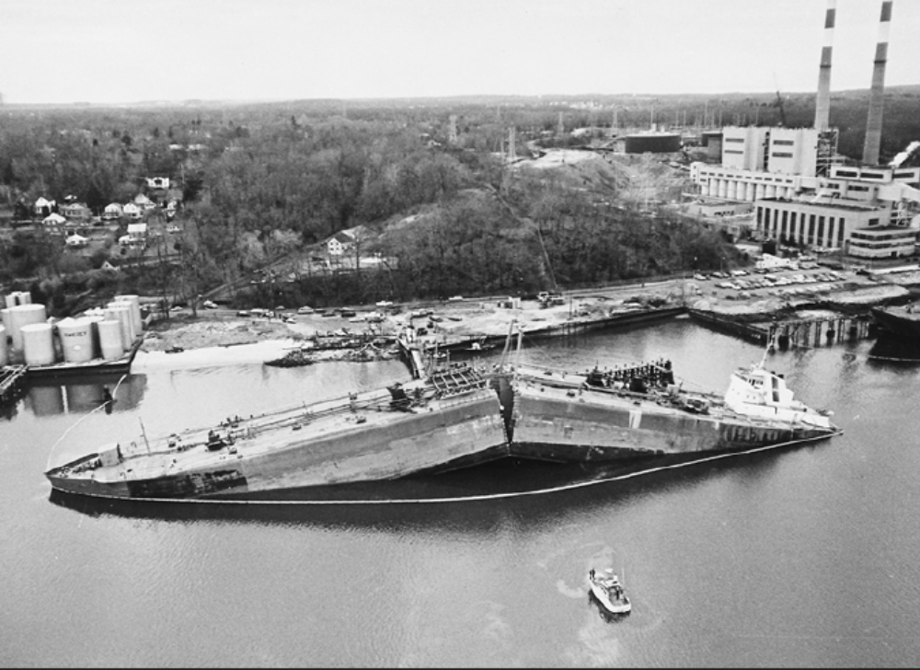
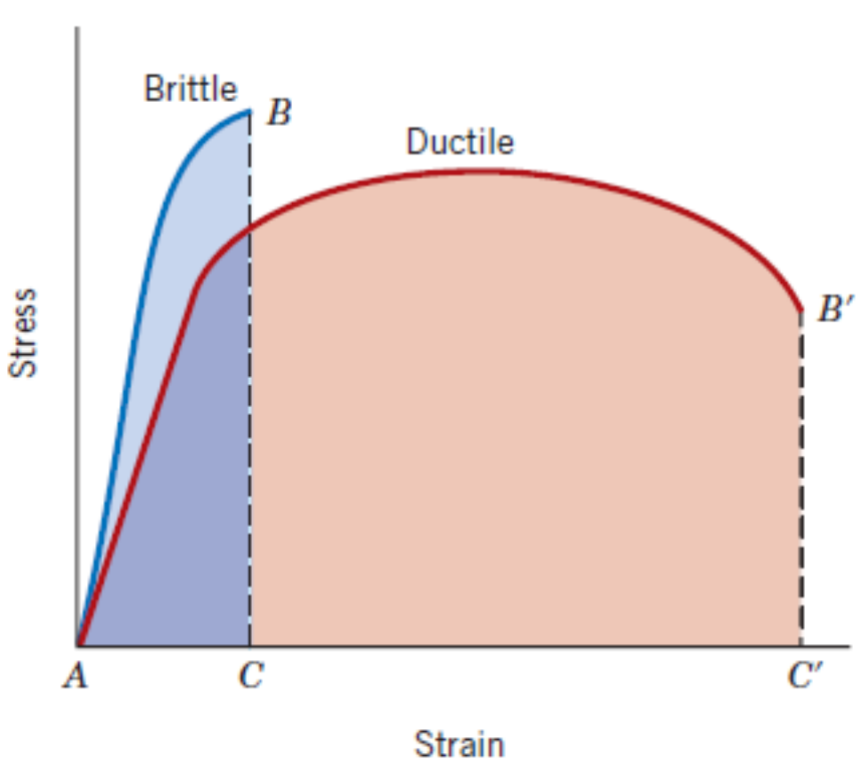
Fracture – Material Separation
Two fracture modes:
Ductile
Brittle

Slide 3
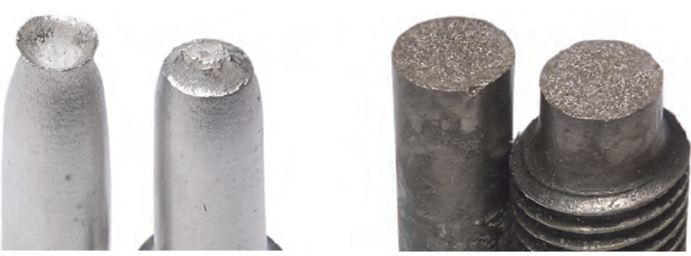
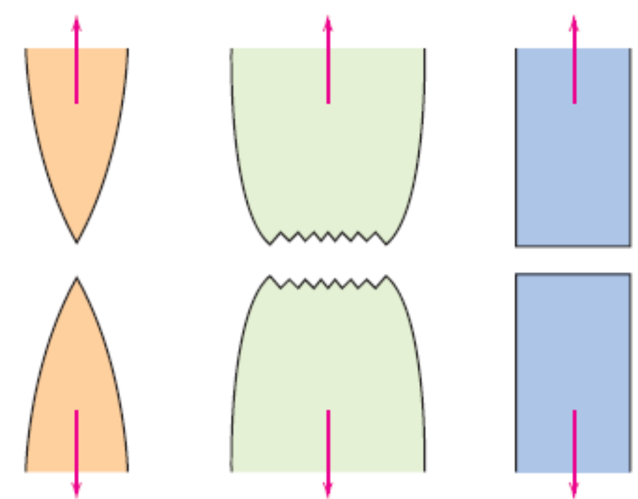
Fracture – Material Separation
Stages of fracture
Crack nucleation
Crack propagation
Highly ductile
Moderately ductile
Brittle

Slide 4
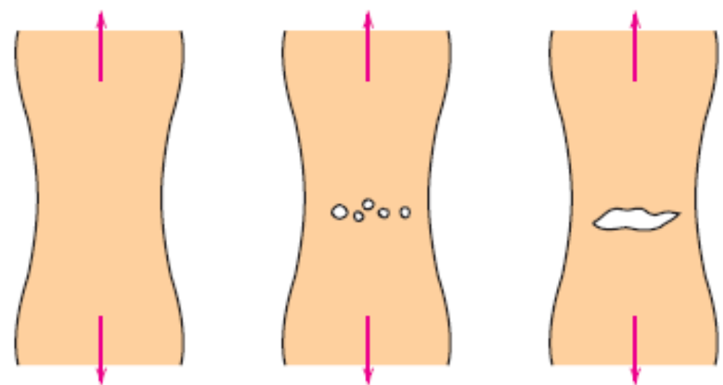
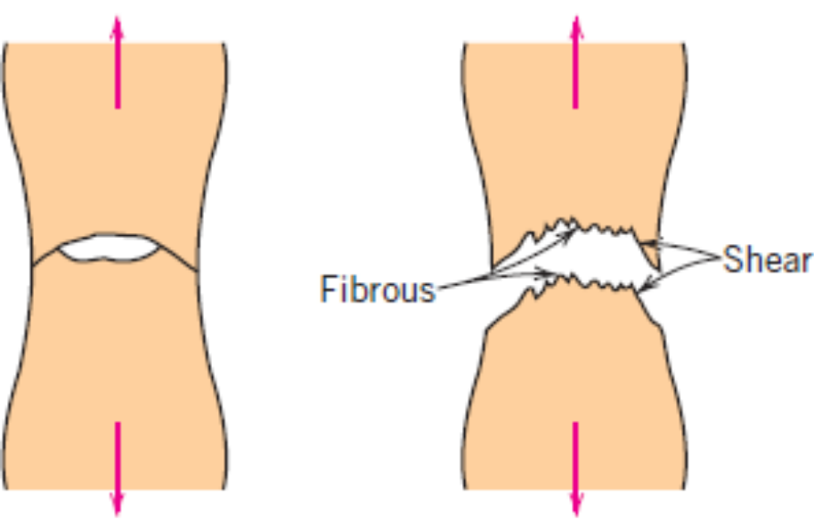
Fracture – Material Separation
Stages of fracture
Crack nucleation
Crack propagation
Cup – Cone fracture process involved in ductile mode of failure of metals

Slide 5
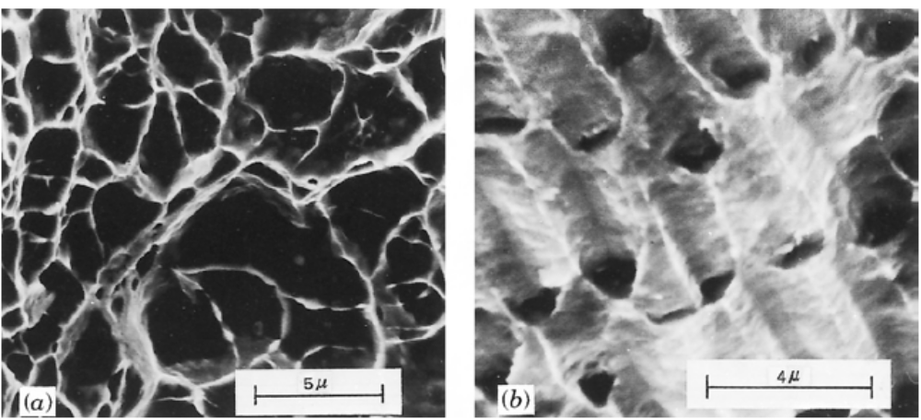
Fractographic Studies – Ductile fracture
(a) Scanning electron fractograph showing spherical dimples characteristic of ductile fracture resulting from uniaxial tensile loads @ 3300X. (b) Scanning electron fractograph showing parabolic-shaped dimples characteristic of ductile fracture resulting from shear loading @ 5000X. (From R.W. Hertzberg, Deformation and Fracture Mechanics of Engineering Materials, 3rd edition. Copyright © 1989 by John Wiley & Sons, New York. Reprinted by permission of John Wiley & Sons, Inc.)

Slide 6
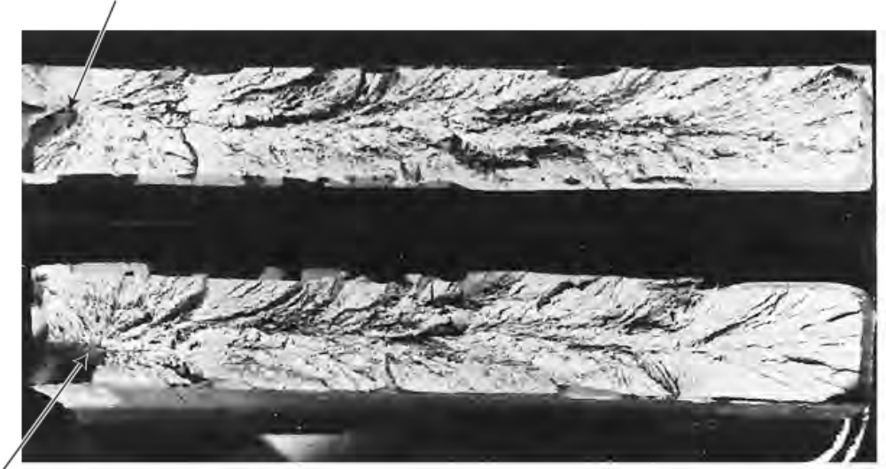
Fractographic Studies – Brittle fracture
Arrows indicate the points of origin of the cracks. V–shaped “Chevron” markings are a typical feature of brittle fracture.

Slide 7
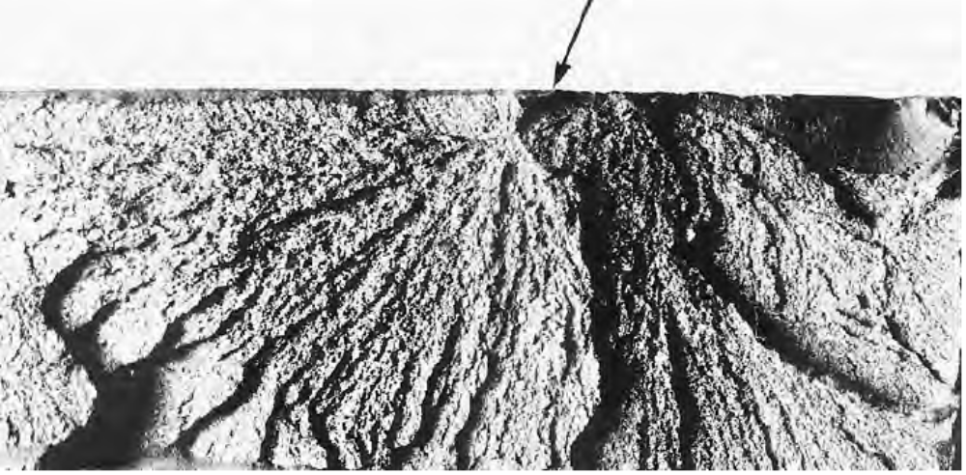
Fractographic Studies – Brittle fracture
Arrow indicates the location of origin of the cracks. Fan shaped radial crack pattern is also typical feature of brittle fracture.

Slide 8
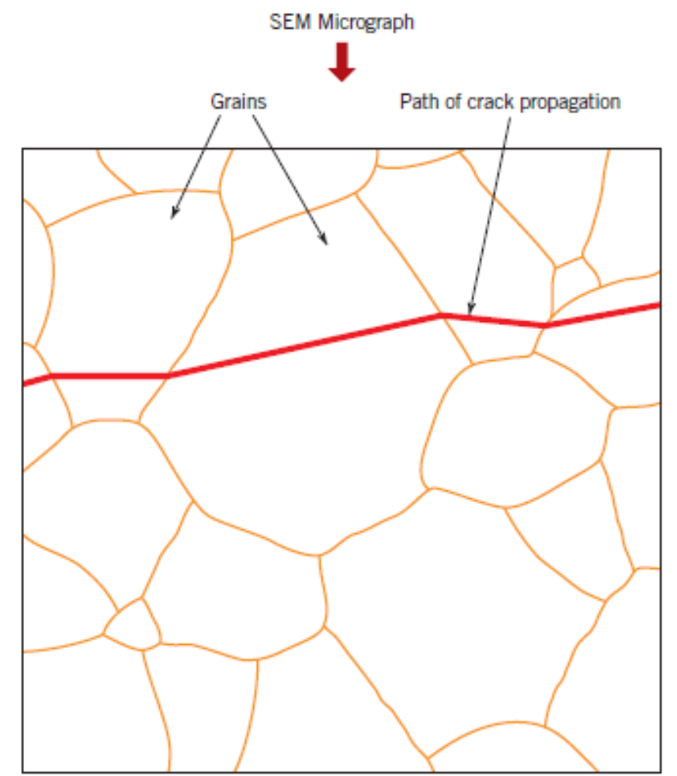
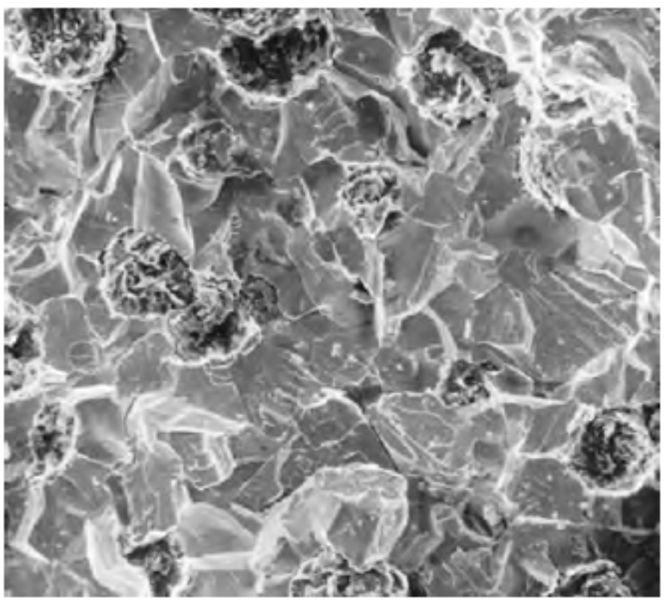
Fractographic Studies – Brittle fracture
Brittle fracture occurs by cleavage of atomic bonds on certain specific crystallographic planes.
Transgranular – crack propagation through the grains
Intergranular – crack propagation along the grain boundaries

Slide 9
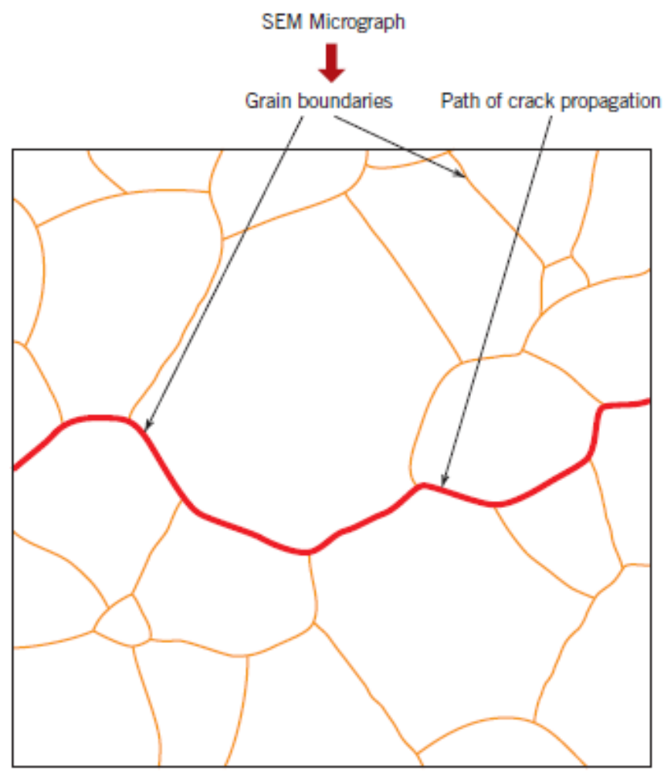
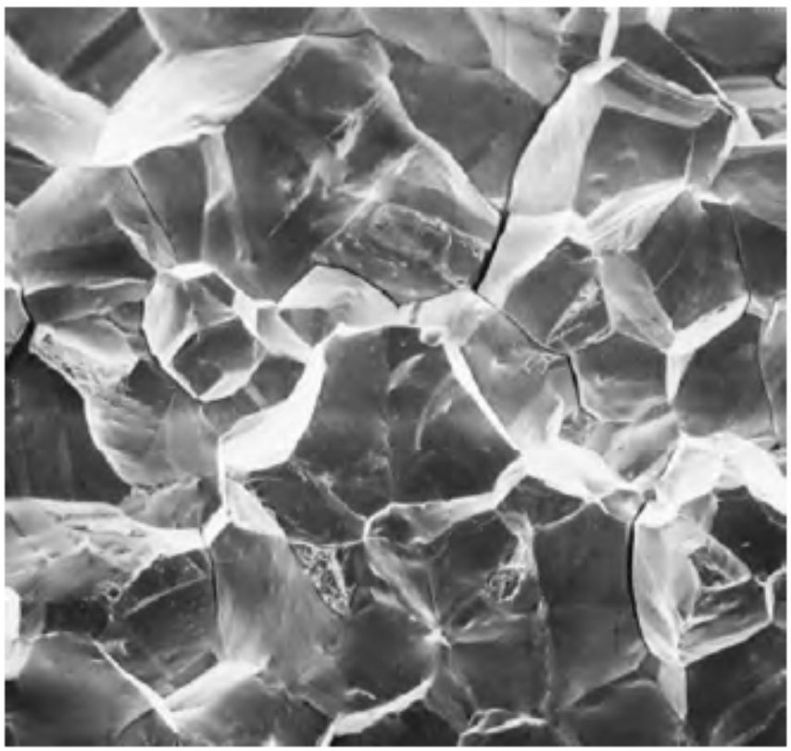
Fractographic Studies – Brittle fracture
Brittle fracture occurs by cleavage of atomic bonds on certain specific crystallographic planes.
Transgranular – crack propagation through the grains
Intergranular – crack propagation along the grain boundaries

Slide 10
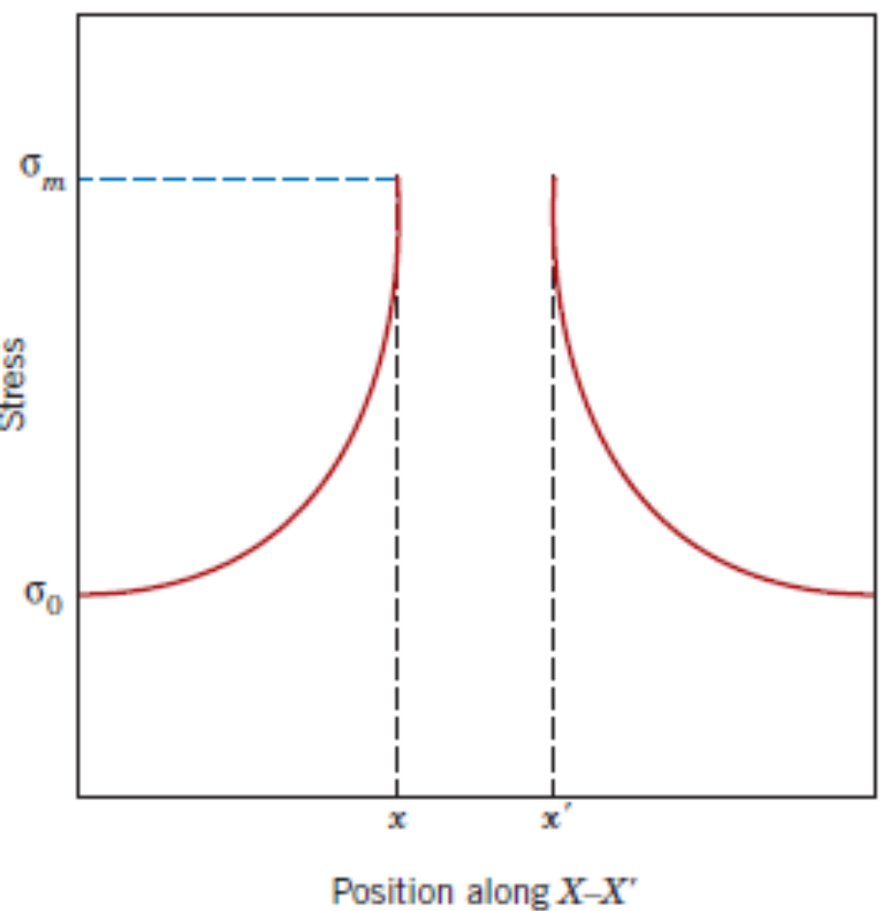

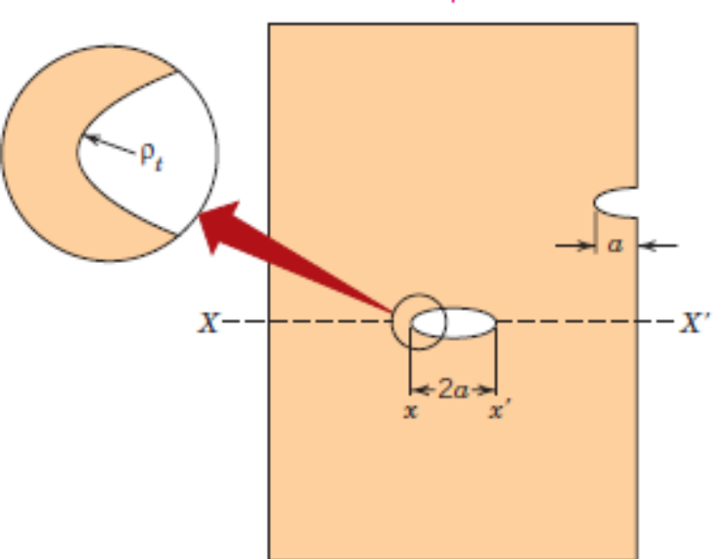
Fracture Mechanics – Stress Intensity Factor – Fracture Toughness
Stress concentration → Stress Intensity Factor → Fracture Toughness
σ₀
σ₀

Slide 11
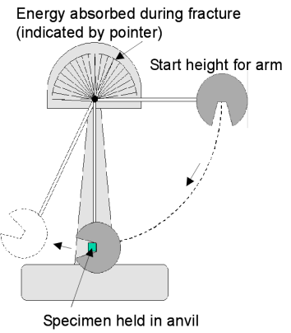
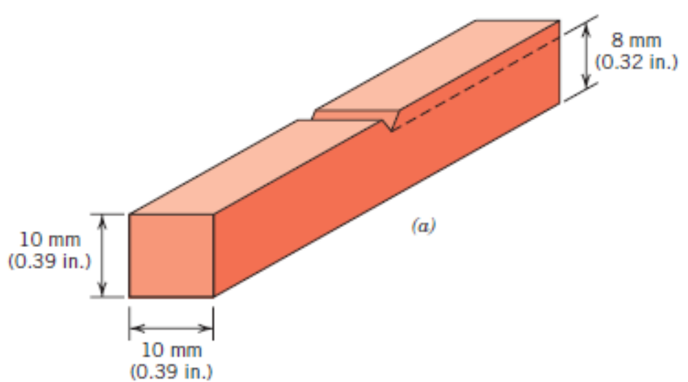
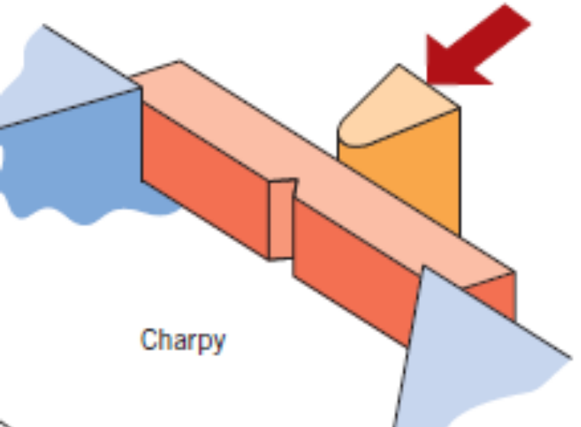
Impact Fracture Testing
Charpy test for measuring impact energy

Slide 12
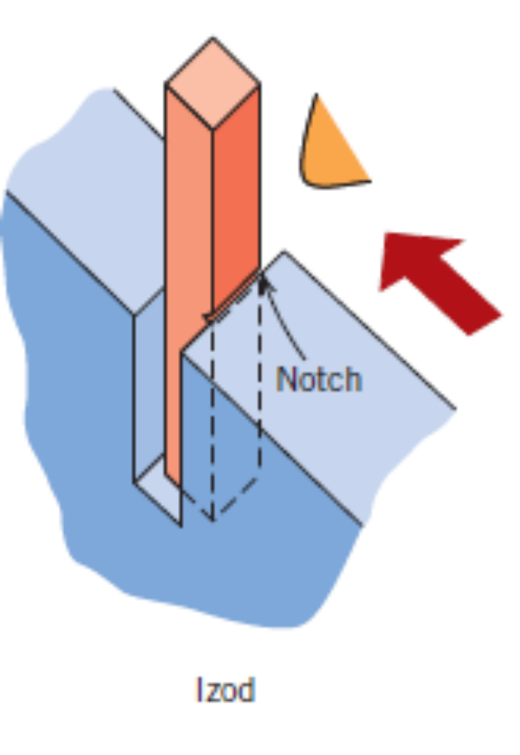
Impact Fracture Testing
Izod test for measuring impact energy

Slide 13
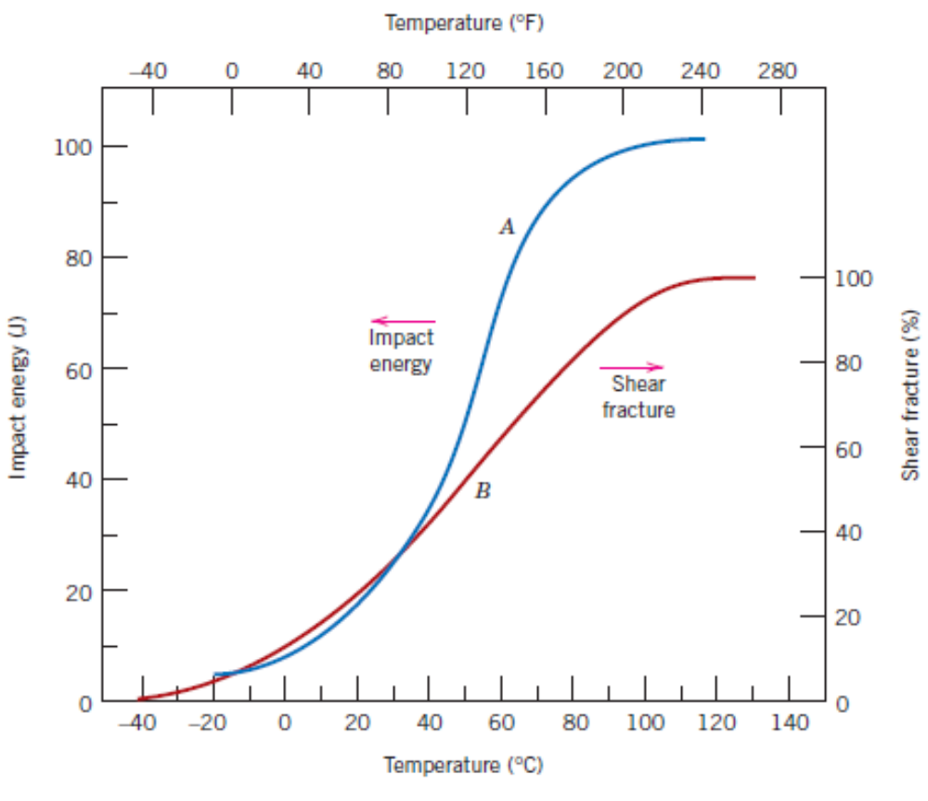
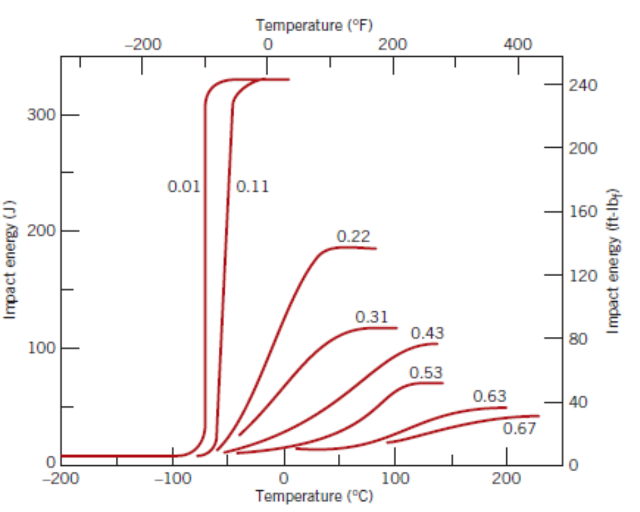
Ductile–to–Brittle Transition
Range of temperatures over which a normally ductile material behaves like a brittle material and undergoes brittle failure.
Influence of carbon content on the dependence of impact energy on temperature

Slide 14
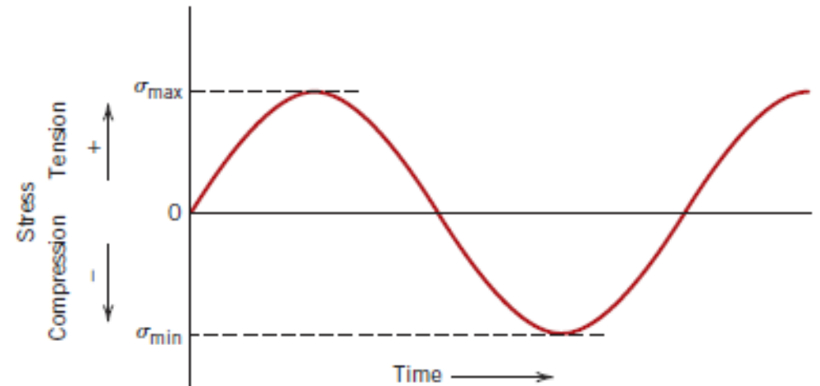
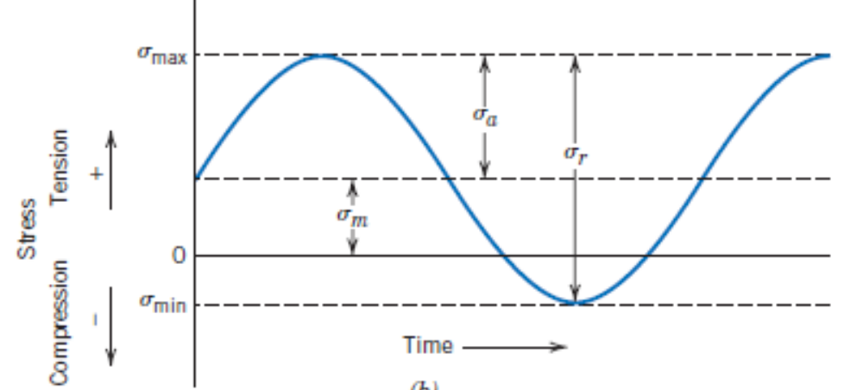
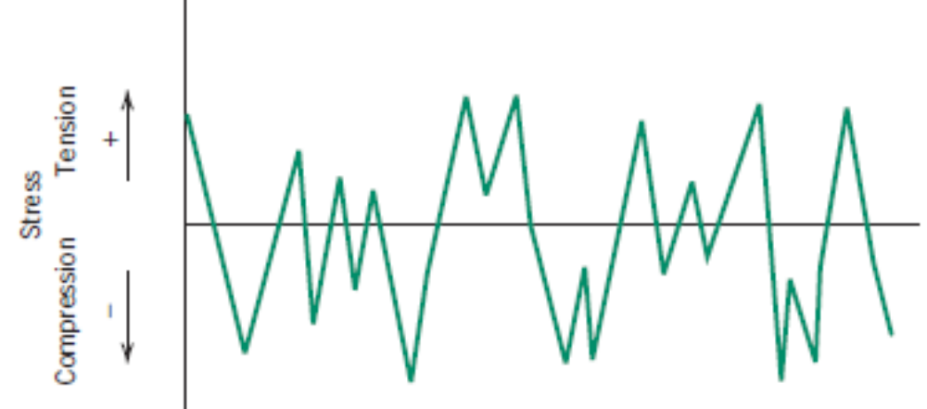
Fatigue Failure

Slide 15
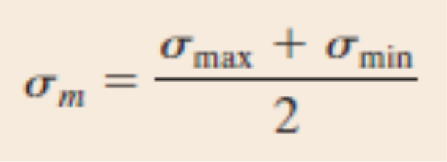
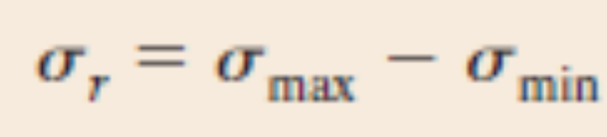
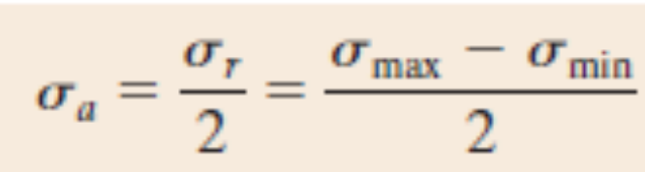
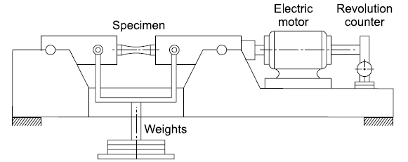
Fatigue Failure
Stress ratio, R = σ_{min}/σ_{max}.

Slide 16
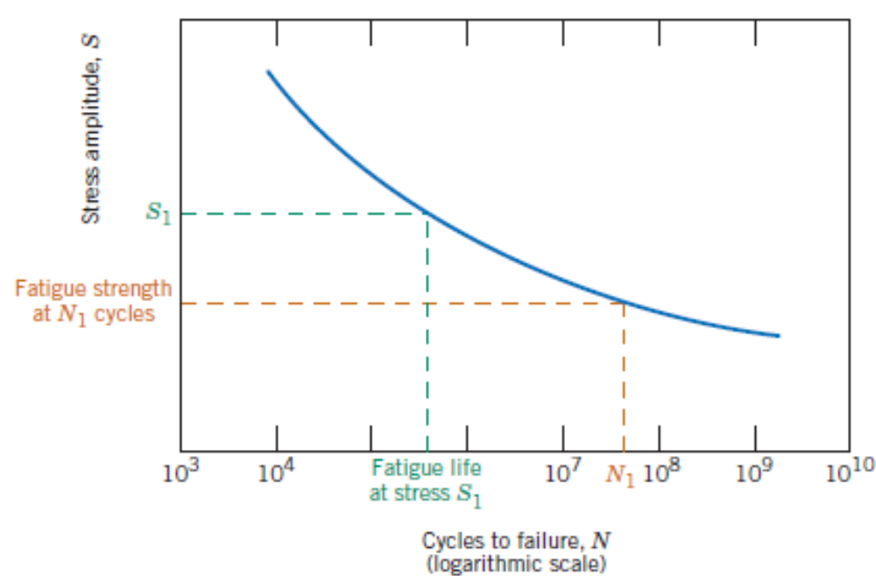
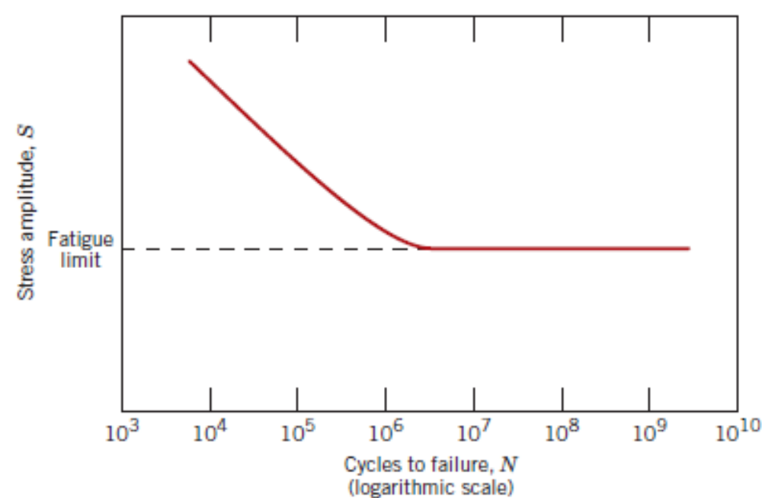
Fatigue Failure: S–N curve
Ferrous Alloys
Non – Ferrous Alloys

Slide 17
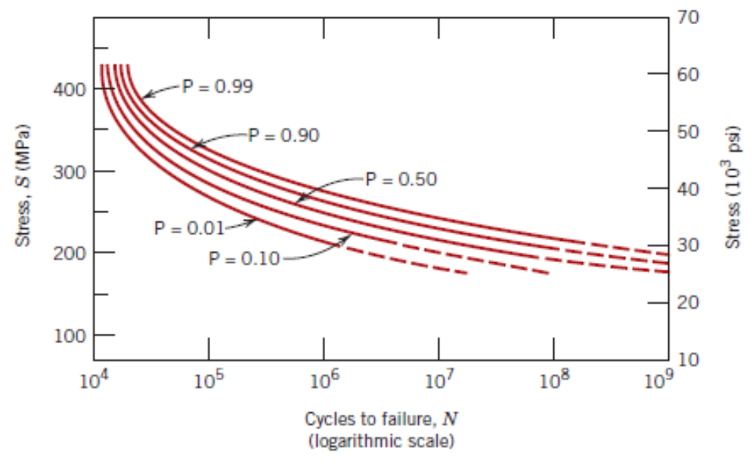
Fatigue Failure: S–N curve – Probability of failure of materials

Slide 18
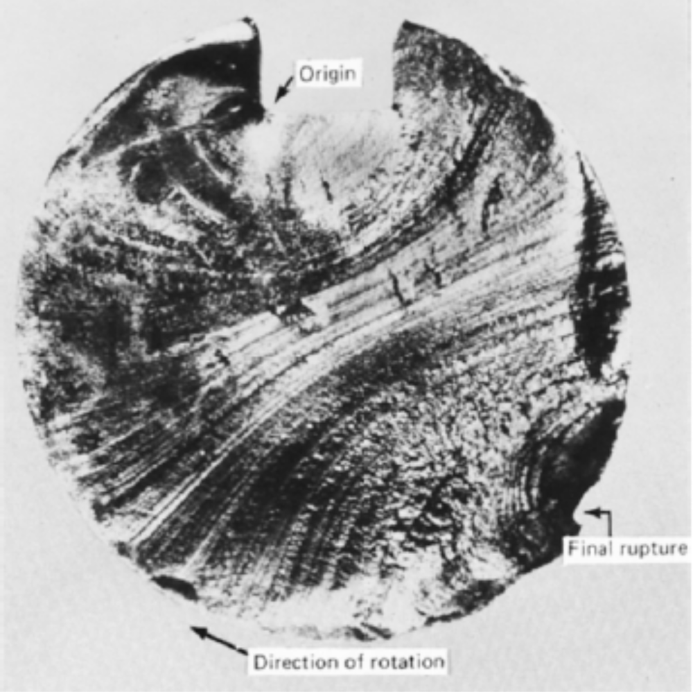
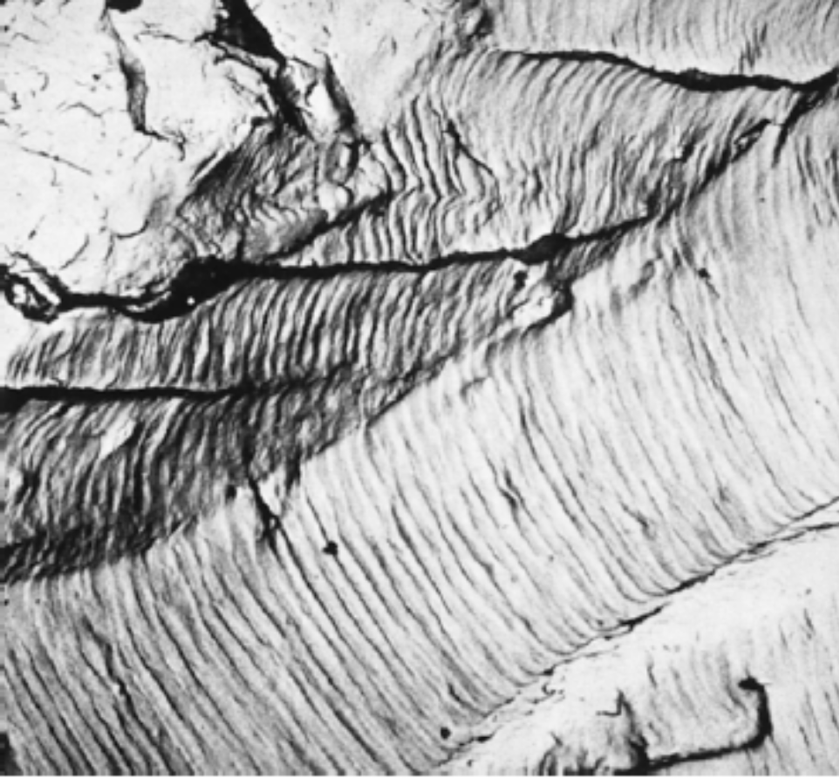
Fatigue Failure: Mechanisms

Slide 19
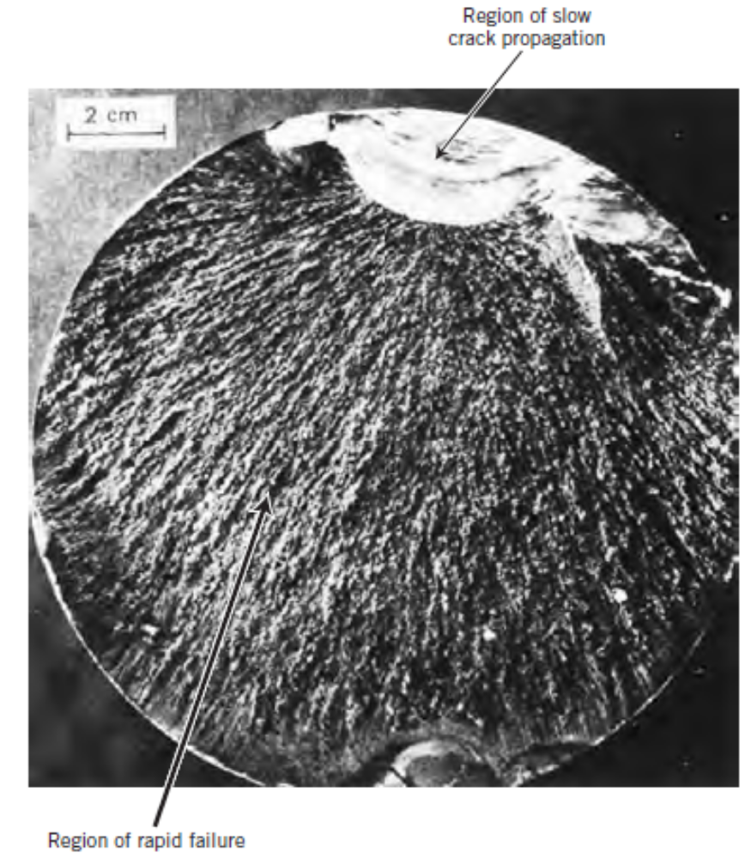
Fatigue Failure: Micrograph showing various stages of fatigue crack growth

Slide 20
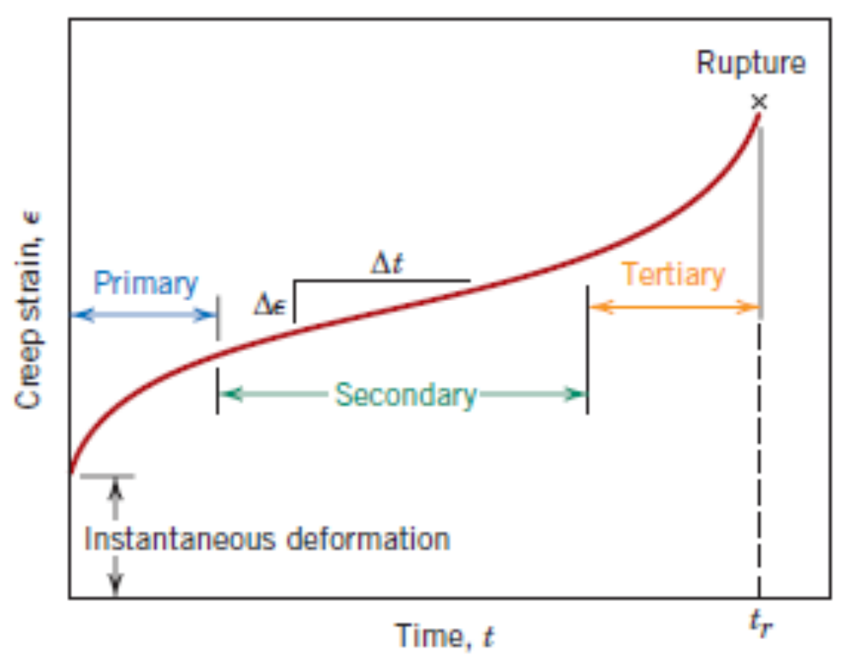
Creep Deformation and Failure
Stress–induced vacancy diffusion; grain boundary diffusion; dislocation motion; grain boundary sliding.

